Slide 1


DR. BABASAHEB AMBEDKAR TECHNOLOGICAL UNIVERSITY, LONERE
In partial fulfillment of the
Degree of B-Tech of Computer Science & Engineering
Submitted By
Name:- Vivek Chandrakant Jadhav
University Roll No:-2062171242021
Project name :- VIDEO PLAYER
Under the Guidance of
Prof.P. S. Powar.
Department of Computer Science & Engineering
ASHOKRAO MANE GROUP OF INSTITUTAIONS, VATHAR
A. Y. 2021-22
1

Slide 2
ACKNOWLEDGEMENT
This work is just not an individual contribution still its completion. I take this opportunity to thank all for bringing it close to the conclusion. A special thanks goes to my Guide, PG Co-ordinator Prof.P. S. Powar, for leading me to many new insights, encouraging and teaching me how to get down to the root of the problem.I am also grateful to Prof.S. S. Redekar and the department faculty and staff members the assistance.
I am also thankful to beloved Dean Academics Prof. P. B. Ghewari and Honorable Director Prof. Dr. H. T. Jadhav for the kind support.I am also thankful to all friends and well-wishers for support during the demanding period of this work. This document, in its eternity (as with everything I have or have yet to accomplish) is attributable to the Parents, whose strength and compassion are my constant inspiration.
I would also like to thank our wonderful Colleagues and friends for listening our ideas, asking questions and providing feedback and suggestions for improving our ideas.

Slide 3
CONTENT
Abstract
Problem Statement
Introduction
Objectives
Minimum Hardware & Software
Methodology
Architecture
Working Model
Limitations
Conclusion
References

Slide 4
ABSTRACT
This project is about playing a video which is stored in system folder. We have
used Hyper Text Markup Language (HTML) ,Cascading Style Sheets (CSS) and
We have used JavaScript (JS) programming language to connect the video to my
Front end project.

Slide 5
PROBLEM STATEMENT
For those who searching for good video player, we created this kind of module
For them. The main purpose of this project is to play the video that are stored in the system
Folder by using JavaScript.

Slide 6
INTRODUCTION
This module is main interface between video player and system folder. By using this application we
Play video that is present in system folder. This application provides picture in picture mode and using the
application we play the video in min and max scale. This module only plays the videos that are stored into the
system or PC. This provide user friendly interface to easy access this application.

Slide 7
OBJECTIVES
7
The of module is to play the video on to the device using java script.
To learn the working and function of java script.
This module provides fast video access by using system folder.

Slide 8
8
Hardware and Software Technology
Minimum Hardware Specification :
( 1 Machine Required of the Following Configurations)
  CPU : Intel Core i3
  RAM : 2 GB
  HDD : 250 GB
Minimum Software Specification:
  Coding Language : Html and Js
  Front End : Html, CSS, JS.3

Slide 9
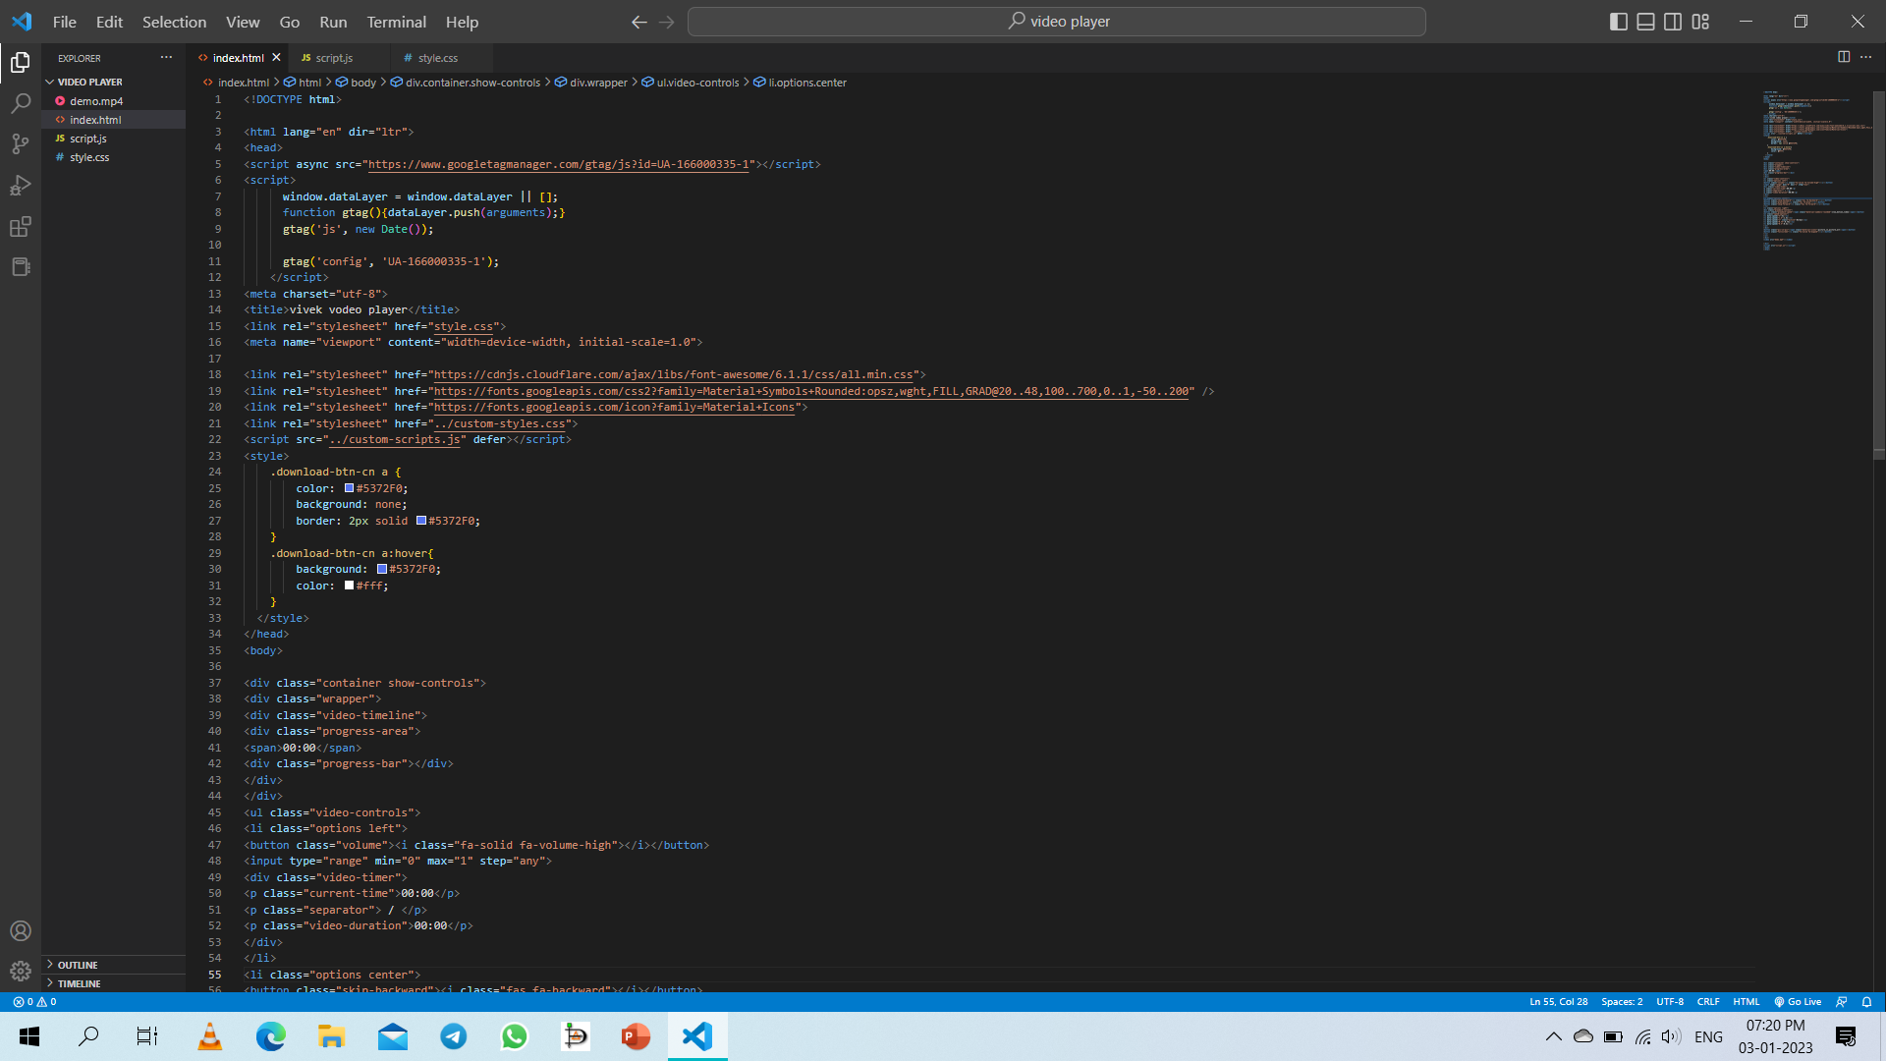
WORKING MODELS
Fig. Source code

Slide 10
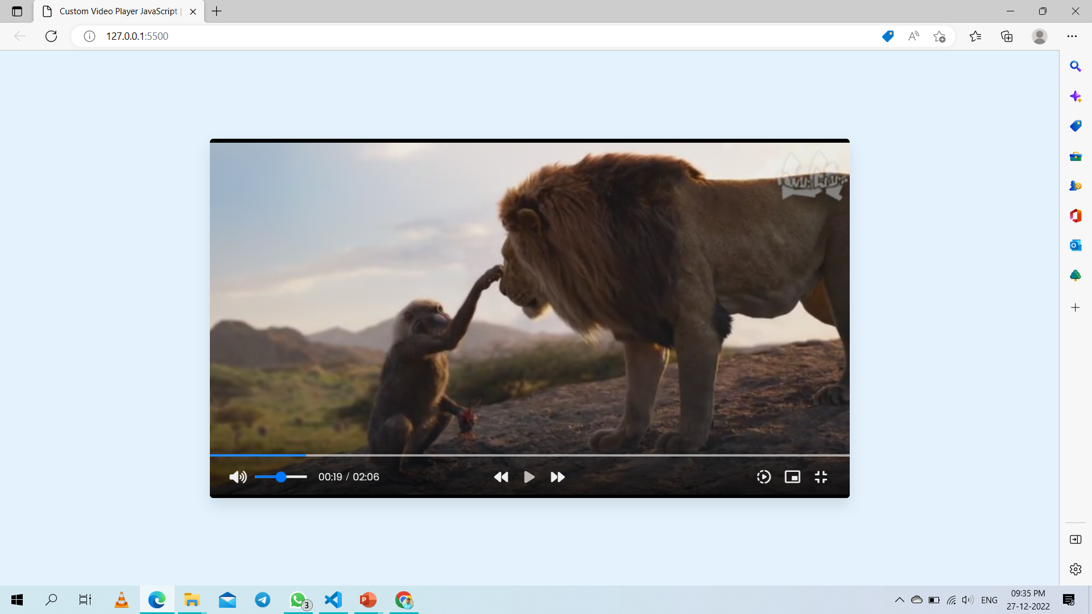
WORKING MODELS
Fig. Output of the project

Slide 11
METHODOLOGY
11
HTML – Hyper Text Markup Language
In this module uses HTML for describing web pages. Html is a markup language. Its contains lot of tags and using that’s tags we create different web-pages for our modules
CSS – Cascading Style Sheets.
Style define how to display html elements. CSS can be use as external internal and also inline.
JS – JavaScript
JavaScript is the Programming Language for the web JavaScript can update and change both HTML and CSS. JavaScript can calculate, manipulate and validate data.

Slide 12
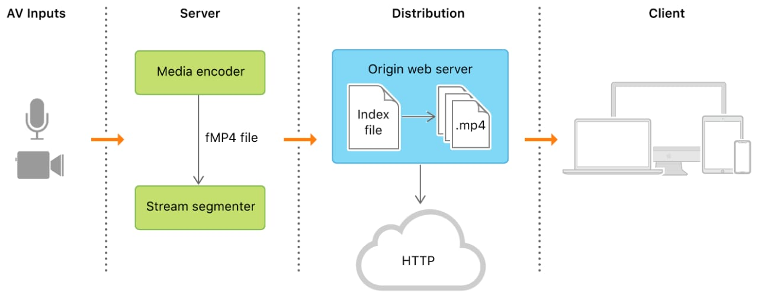
ARCHITECTURE

Slide 13
Limitations
  This module only plays the videos that are stored into the system or PC.
  We have to specify the path and video name into JavaScript each time when we want to add the new video.
  Only one video will be play at a time.
  In this project we didn’t use the video process bar or volume bar.
  We have to adject volume from the system.

Slide 14
CONCLUSION
JavaScript is a very important language for creation of new modules for better scripting, connectivity and better performance since it is a lightweight language and this music player can be upgraded in the future and more songs can be stored .

Slide 15
REFERENCES
www.w3school.com
www.javapoint.com
www.designcrowd.com

Slide 16
Thank You…

